Slide 1
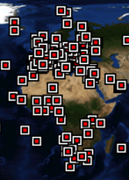
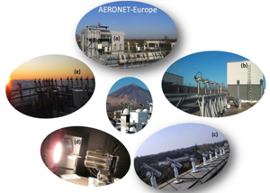
AERONET Europe 2011-2019 8 years supporting scientific research and innovation in Europe and Worldwide
P. Goloub, C. Toledano, E. Cuevas et al.
+ PI + SM
CNRS, UVA, AEMET

Slide 2
Our objectives ?
Long-term ground-based aerosol high quality observation and monitoring
“Calibration”, Trainings, Good practice (academic and private users).
New technologies (increase technology readiness level, in collaboration with SMEs)
(i) Lunar photometer CE318T;
(ii) Mobile Automatic photometer CE318TM;
(iii) Polarimeter CE318T;
(iv) Promote compact and automatic integrated systems;
(v) Low cost handheld photometer;
(vi) …
Integration/synergetic activities (photometer, LiDAR, in situ, satellites and modelling)
Added value products (through innovative algorithms, e.g. GRASP) & through ACTRIS-DC
Maintain ACTRIS-services in the long-term (upgrade of calibration platform, technologies, data processing and … preserve human resources and expertise).

Slide 3
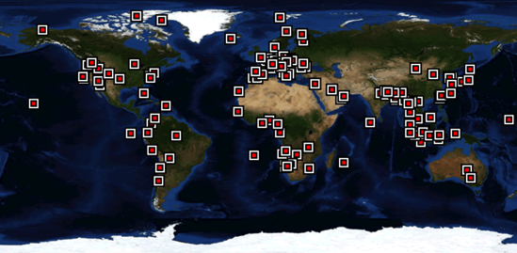
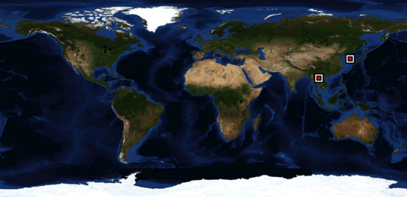
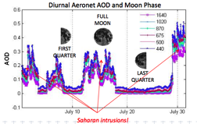
Evolution ?
Distribution of CE318T (« model T »), Sun + Moon + Faster robot + New control box
Early 2019
(2014 = 0)
Around 130 sites in the network (upgrades + new sites) in 2019
About 30% (45 sites) in ACTRIS perimeter
This short presentation: major technical and scientific outcomes supported by the European branch of AERONET during ACTRIS-1 and ACTRIS-2
(17 talks/posters on/using AERONET, in this Workshop)
Notes:
Released in 2019 by NASA
Released by AERONET Europe in 2016, for AERONET Europe first station

Slide 4
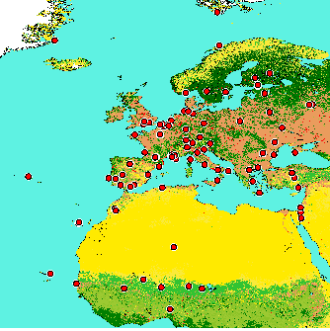
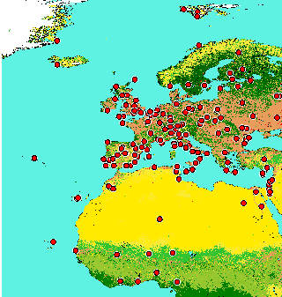
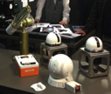
Development of European Capacity
2010
2018
-Perimeter
- Research (aerosol properties, variability, trends and impacts,…)
- Earth Observation space missions
- Partnerships with WRC/NPL for traceability
- Partnerships with SMEs
- Innovation (instrument, methodology, data processing and aerosols retrievals)
- Data Center and Services
Papers (Extr.) : Baretto et al., Li et al., Kazadzis et al., Toledano et al., Lopatin et al., Cuevas et al.,
Karol et al., Torres et al., Popovici et al., Mortier et al.,…
Notes:
At present, about 10 sites are still under NASA control for calibration

Slide 5
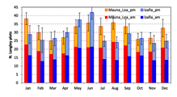
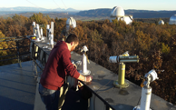
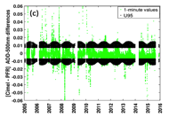
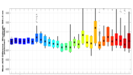
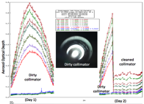
Support to « calibration »
Solar (absolute, transfer)
Radiometry (absolute)
Polarimetry (absolute)
Alternative methods (AOD-to-radiance transfer)
Lunar (absolute, transfer)
Link and Traceability with other networks/WMO
Maintenance
QC/QA

Slide 6
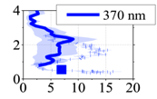
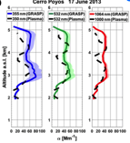
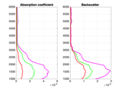
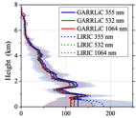
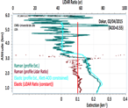
Support to Aerosol Characterization (1/2)
Algorithm development and validation (synergy)
- Photometer and LiDAR
. Algorithm GARRLIC, at AERIS DC (prototype chain)
=> special activity on absorption profiling
. Algorithm LIRIC
- Photometer, single wavelength LiDAR/Ceilometer and in situ
. Algorithm BASIC (AERIS Data and Service Center, in routine)
See joint presentation from (Oleg Dubovik & Nicolas Pascal, Wednesday)
+ poster Nicolas Pascal PS-PT12
+ poster Anatoli Chaïkovsky PS-OCA28
Tsekeri et al.; Chaïkovsky et al., Benavent-Oltra et al.; Mortier et al., Lopatin et al; Hu et al., …
Notes:
Link with in situ-
BASIC, used in routine in AERIS
Tsékeri et al., (Valid -> link with in situ)
Hu et al., moderate and high content (SHADOW-2)
Night time, GRASP, Granada
Night time, BASIC/Raman (Dakar)

Slide 7
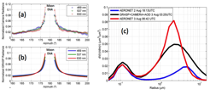
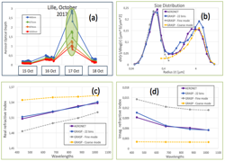
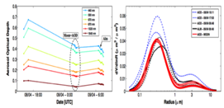
Support to Aerosol Characterization (2/2)
Synergy between lunar photometer and night-time sky imager (GRASP)
Improved Photometer stand-alone retrievals
- AOD and radiance, separation fine and coarse mode ref. index
(GRASP)
- AOD only retrievals -> Size Distribution
(GRASP-AOD, AERIS-DC, in routine)
Papers (extr.): Roman et al.; Torres et al.;., …

Slide 8
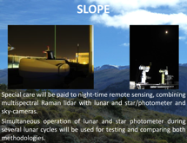
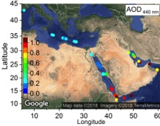
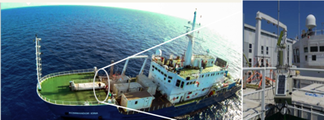
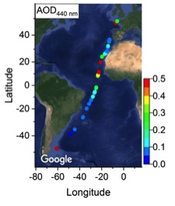
Support to Field Campaigns
Lend, manage, integrate, calibrate, data processing of standard & specific instrument for campaigns
Germany (Melpitz), Greece (Athens), Cyprus (Nicosia), Spain (Granada, Slope), SHADOW-2 (Africa, Dakar), OCEANET I&II (Atlantic), AQABA (Cyprus), CHARMEX (Mediterranean), USA (DRAGON), China (MOABAI), AEROCLO-SA (Namibia),…
AQABA
New automatic mobile sun/sky/lunar-photometer CE318TM
Scheduled campaigns: Polarstern (Artic), New Zealande, etc…,
Project of permanent mobile observation : Marion Dufresne (Indian Ocean)
OCEANET
See Poster PS-PT13, Popovici et al.
PS-PT4, Benavent-Oltra et al.,
Yin et al., AMT, submitted
Unga et al., EGU

Slide 9
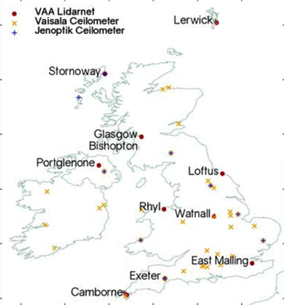
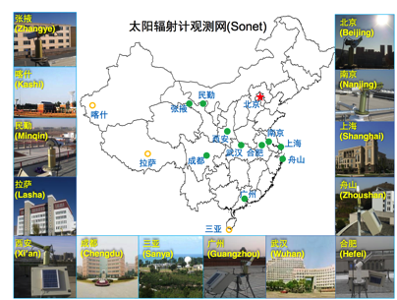
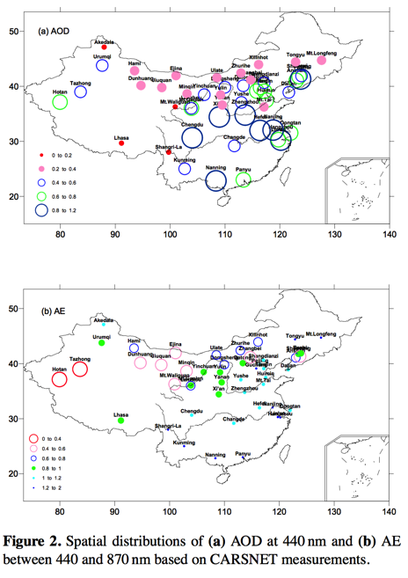
Support to Other Networks
UK Met Office (field instruments, training)
Chinese Networks (SONET, CARSNET)
Reference instrument, calibration methods,
Joint research activities
(Adam, Buxmann et al.)
SONET
First Chinese Ground-based aerosol climatology, 2002-2013
CARSNET
SONET Network (Li et al.; RADI/CAS)
Che et al.; CMA

Slide 10
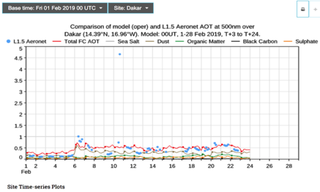
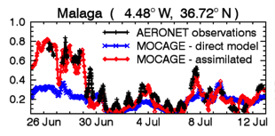
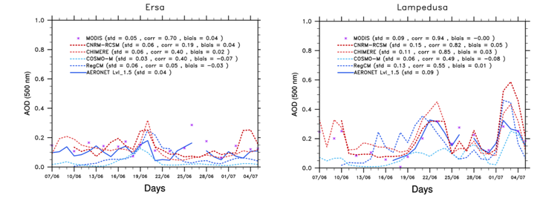
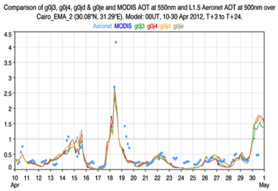
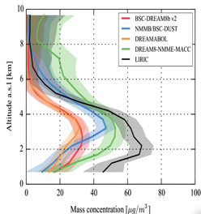
Support to Modelling
ECMWF/MACC (AOD)
CAMS Verification time series (AOD)
WMO-SDS-WAS (DREAM, Dust Model)
AEROCOM (Verification)
MOCAGE, CHIMERE (Verification)
Emission evaluation (Inverse modelling)
…
…
ECMWF/MACC
Basart et al.; Cuevas et al.; Binietoglou et al.; Sic et al.; Cheng et al.;
Di Tomaso et al.; Gliss et al., Benedetti et al.; Remy et al.;…

Slide 11
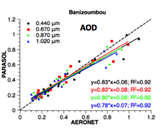
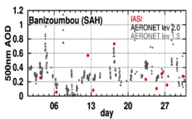
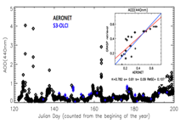
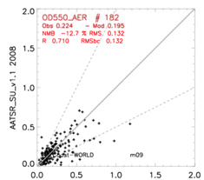
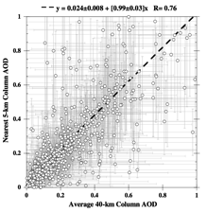
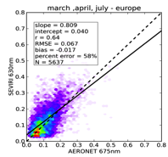
Support to past, present and future Earth Observation Missions
Reference Measurements for validation/calibration of satellites sensors/products (MERIS, AATSR, PARASOL, IASI, OLCI, SEVIRI, MODIS,CALIOP,...
25 year-QA-database (version 3) for satellite cal/val exercises
(now including 4 year-Night time AOD)
ESA-Climate Change Initiative (CCI) inter-comparison
ESA-Instrument Data quality Evaluation and Analysis Service (IDEAS)
(uncertainty, traceability, calibration facility, cal/val campaigns)
ESA-Quality Assurance 4 Earth Observation (QE4EO) program
Future COPERNICUS/EUMETSAT missions; ESA/JAXA EARTHCARE
Other Non EU missions
PARASOL
IASI
OLCI/S-3
MTG (S-4 mission, UVN)
EPS-SG (S-5 mission)
3MI, IASI-NG, …
CALIOP
AATSR (CCI)
Descloitres et al., poster PS-AV16
Papers (extr.): Capelle et al.; de Leeuw, Dubovik et al.; Cuesta et al.; Carrer et al.; Bernard et al., Omar et al.; Waquet et al.; Holzer-Popp et al.; Vandenbussche et al.; Amiridis et a., 2015, ACP (CALIOP).
SEVIRI

Slide 12
Summary / Conclusions
2009 (80)
French and Spanish expertizes, motivation and partnership
Services provided to a wide community
Services is much more than “Calibration”, … CARS
Favor integration between column, profiles, … CARS (+ in situ)
Centralization of processings (monitoring, calibration, retrievals)
Public and Real Time access to QC/QA data
Each site not expert in photometry to get & provide data
Partnership with non AERONET network (e.g. China)
Partnership with non CIMEL networks (WMO/PFR, SKYNET,…)
Partnership with SMEs
Scientific Achievements (publications, data widely used)
Innovation: instrument, algorithm, services
> Relevant instrumental concept, with expected potential evolutions
- integrated passive/active/in situ stationary or mobile system;
- high spectral resolution; sky imager
> Relevant aerosol retrieval concept with GRASP
2018 (130)
Access Unit provided: All together : 416 ua (expected: 335)
(48 M) CNRS : 200 ua (expected : 165)
UVA : 130 ua (expected : 100)
AEMET : 86 ua (expected : 70)

Slide 13
ACTRIS 2019 . . . . 2024 . . . . . . .
Perspectives 2024
04/2019, ACTRIS-2
One important key of success is the adequate human resources
in France and Spain during ACTRIS-1/2
ACTRIS-RI, a major partner of AERONET
Newsletters AERONET-Europe at http://www.actris.eu/Portals/46/Outreach/Newsletters/
Educational program Globe/Calipsph’air (Calitoo, http://www.calitoo.fr)

Slide 14
Development of European Capacity
2010 (80)
Notes:
At present, about 10 sites are still under NASA control for calibration

Slide 15
Development of European Capacity
2018 (130)
Notes:
At present, about 10 sites are still under NASA control for calibration

