Slide 1
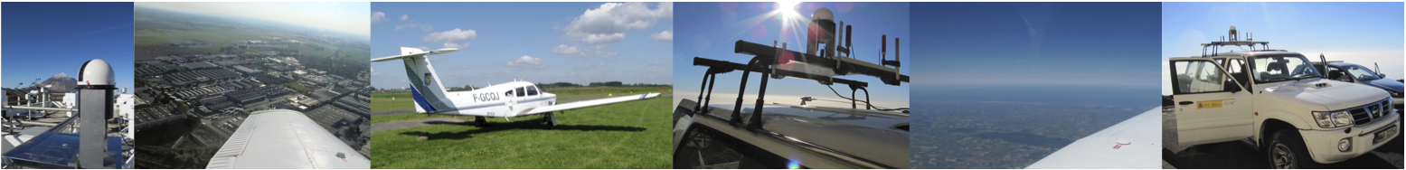
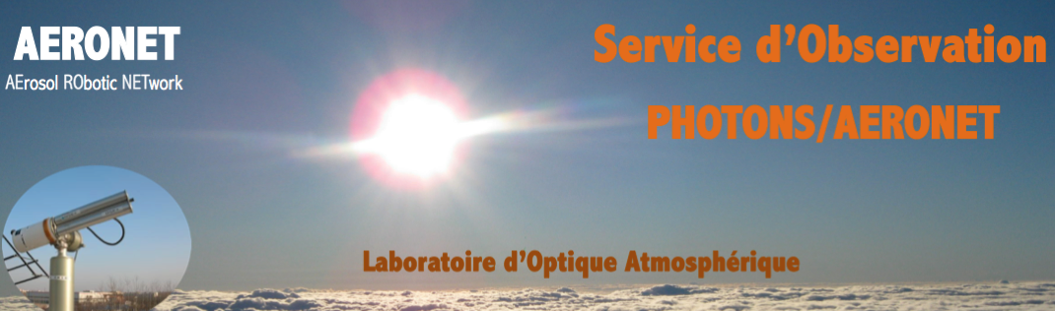
Aerosols spatial distribution (vertical / horizontal)
using
the multi-wavelength
airborne sun-photometer PLASMA
Laboratoire d’Optique Atmosphérique,
Université des Sciences et Technologies de Lille,
FRANCE

Slide 2
Introduction
The purpose of the development of airborne multi-wavelength sun photometer was to design an instrument that would directly measure the vertical profiles of AOD at different wavelengths in order to make these data for validation of ground-based and space-borne LIDAR measurements. LIDAR measures the backscattered laser light and the LIDAR equation cannot be solved without an additional constraint such as independent optical depth measurements easy to derive as long as the photometer is well calibrated. Thus, the first objective of PLASMA was to have a tool for the validation of LIDAR data.
It was decided to use a wide spectral range to be able to derive information on aerosol size distribution from AOD measurements (King et al., 1978). Thus, the second objective was to get the size distributions of aerosol particles at different altitudes. Since last decades, similar airborne sunphotometers were developed (Matsumoto et al., 1987; Schmid et al., 2003; Asseng et al., 2004) but the PLASMA feature is its lightness so that it can be easily installed on a small airplane or an automobile. That was the third objective: the mobility of the instrument. As the instrument must be installed on the moving platform, the system requires accurate Sun tracking and connection to the GPS navigation system. Moreover, as the airplane speed is about 200 km/h, the frequency of the measurements at different channels must also be high enough for acquiring a whole data set within around one second. The installation on the body of the aircraft or on the roof of the automobile results in the necessity of complex computer control. A sophisticated software is required for the best automatisation of the measurements.

Slide 3
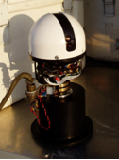
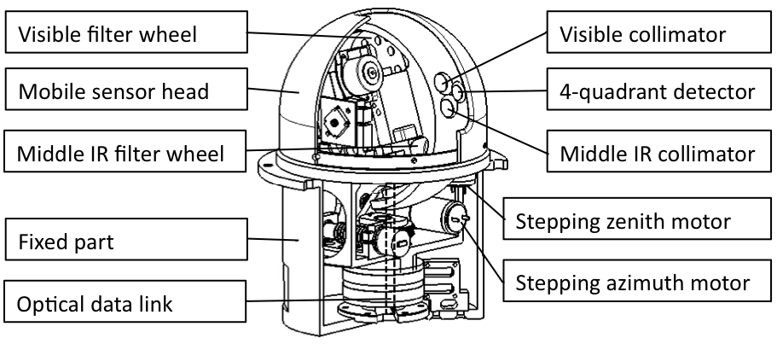
Airborne sun photometer PLASMA
Photomètre Léger Aéroporté pour la Surveillance des Masses d’Air
15 channels
340 – 2250 nm

Slide 4
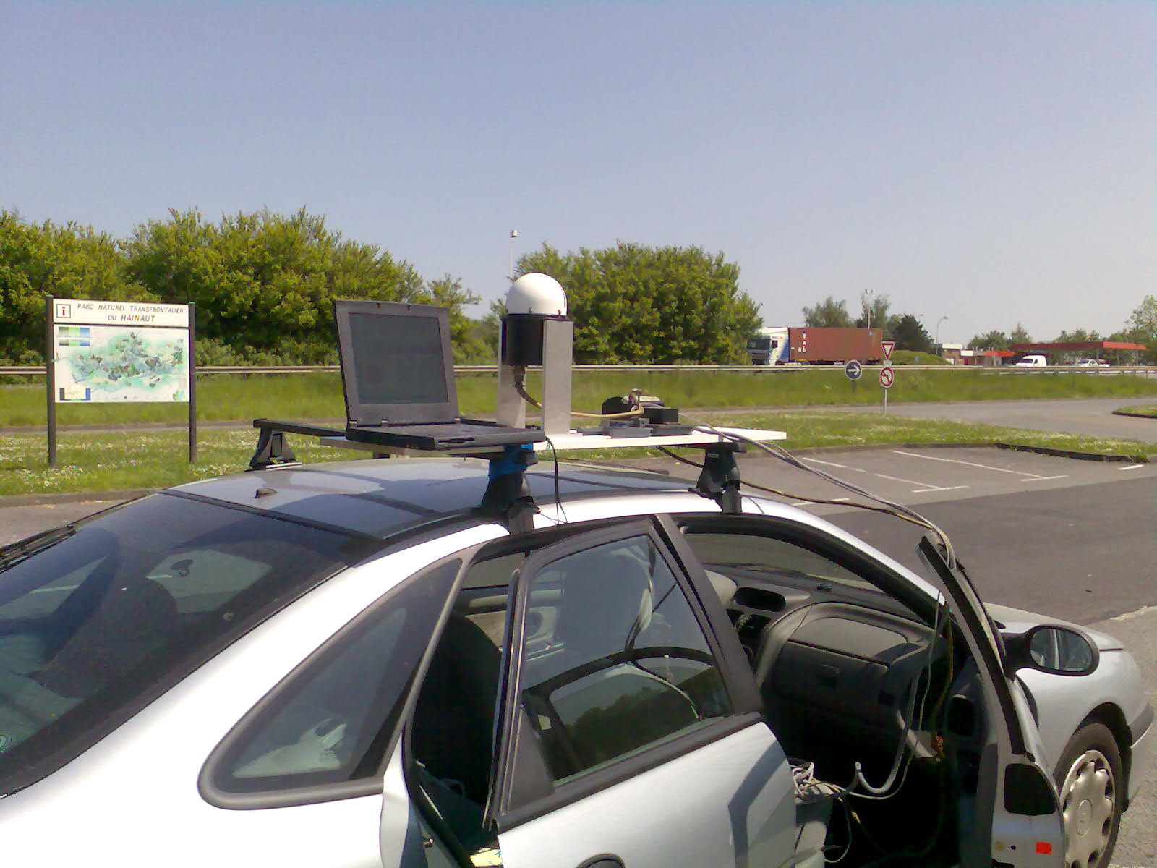
Sun photometer PLASMA
Debuggage session on Highway, Near Lille, 2009

Slide 5
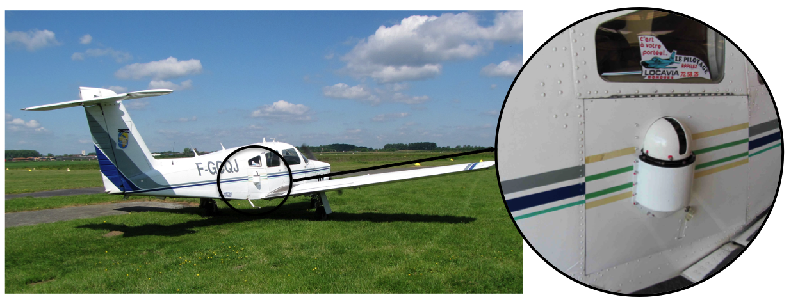
Airborne sun photometer PLASMA

Slide 6
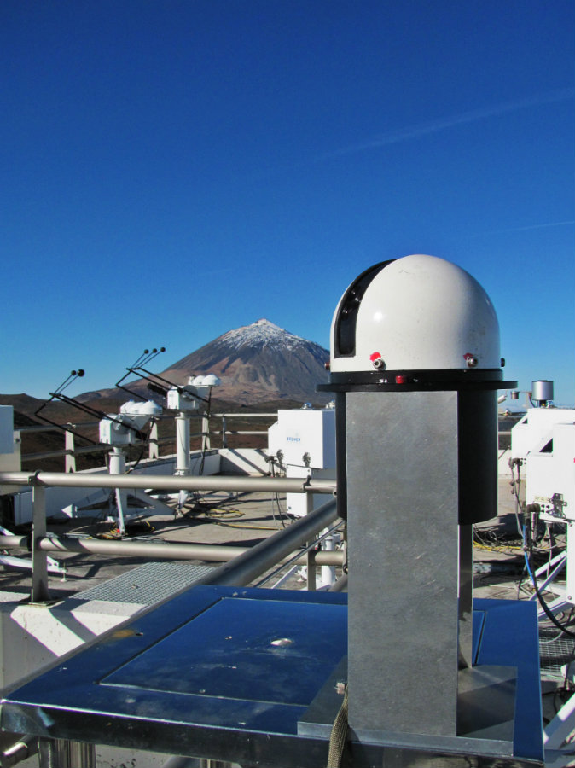
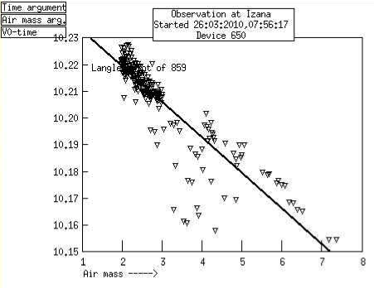
Langley Calibration (like AERONET master)
τ

Slide 7
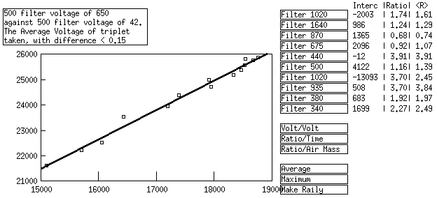
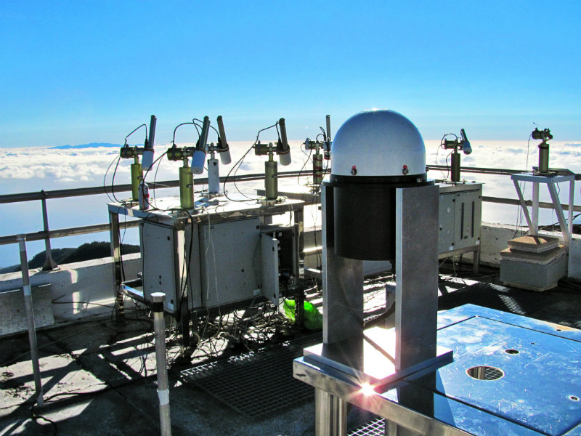
Inter-calibration (like AERONET Field instrument)
only CIMEL wavelengths
can be calibrated

Slide 8
PLASMA advantages
wide spectral range: 340 – 2250 nm
accurate Sun tracking
weight: 3.5 kg + 2-4 kg for electronics
frequency of measurements:
1 measurement in 100 m for a speed 200 km/h

Slide 9
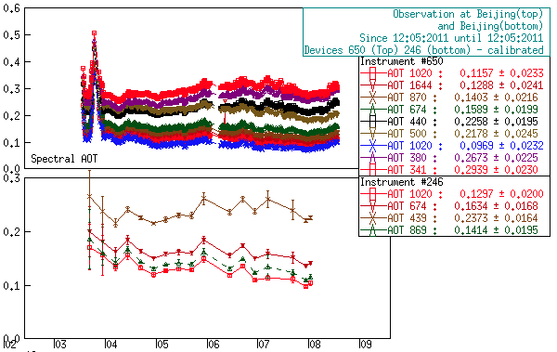
Example of Ground-based measurements
Beijing
0.05 < ΔAOD < 0.01
PLASMA is the instrument #650 AERONET database

Slide 10
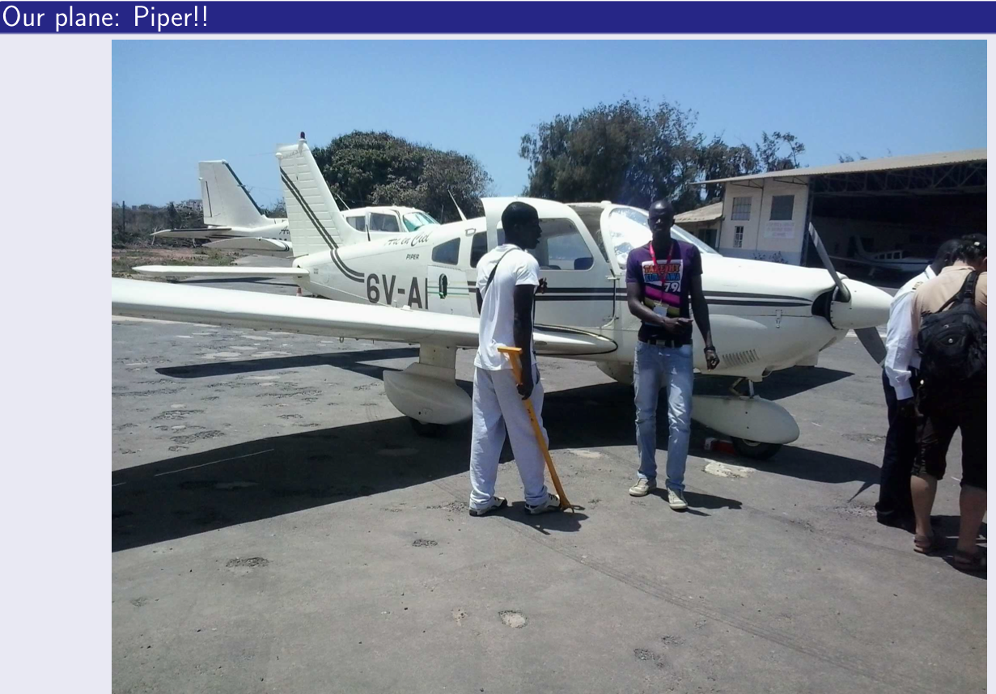
PLASMA data inversion
Airborne measurements: Dakar – M’Bour

Slide 11
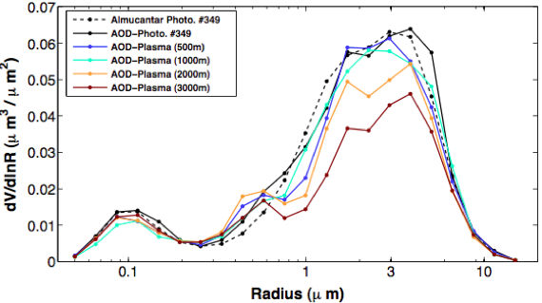
PLASMA data inversion
Airborne measurements: Dakar – M’Bour
Size Distribution change with altitude
Torres et al., 2013, LOA
Spectral AOD + refractive index from AERONET at all altitudes

Slide 12
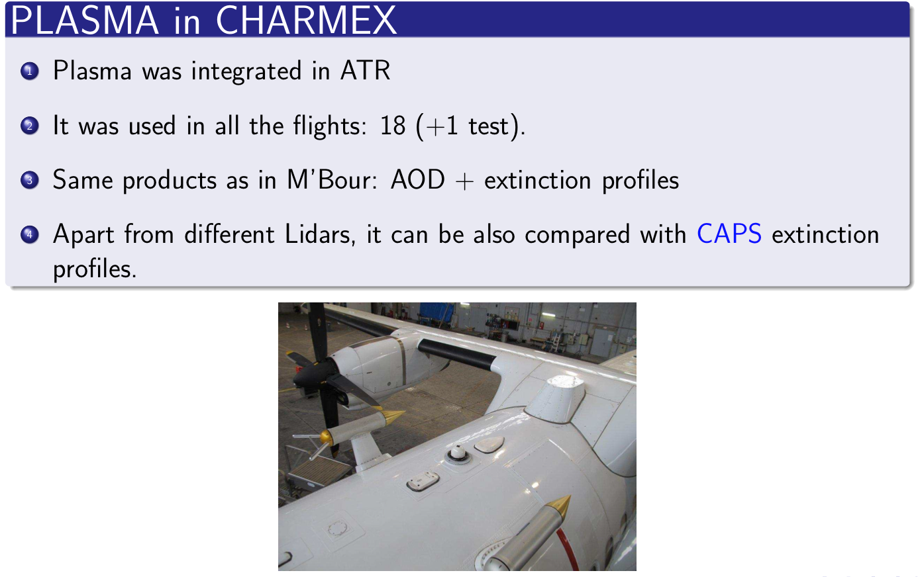

Slide 13
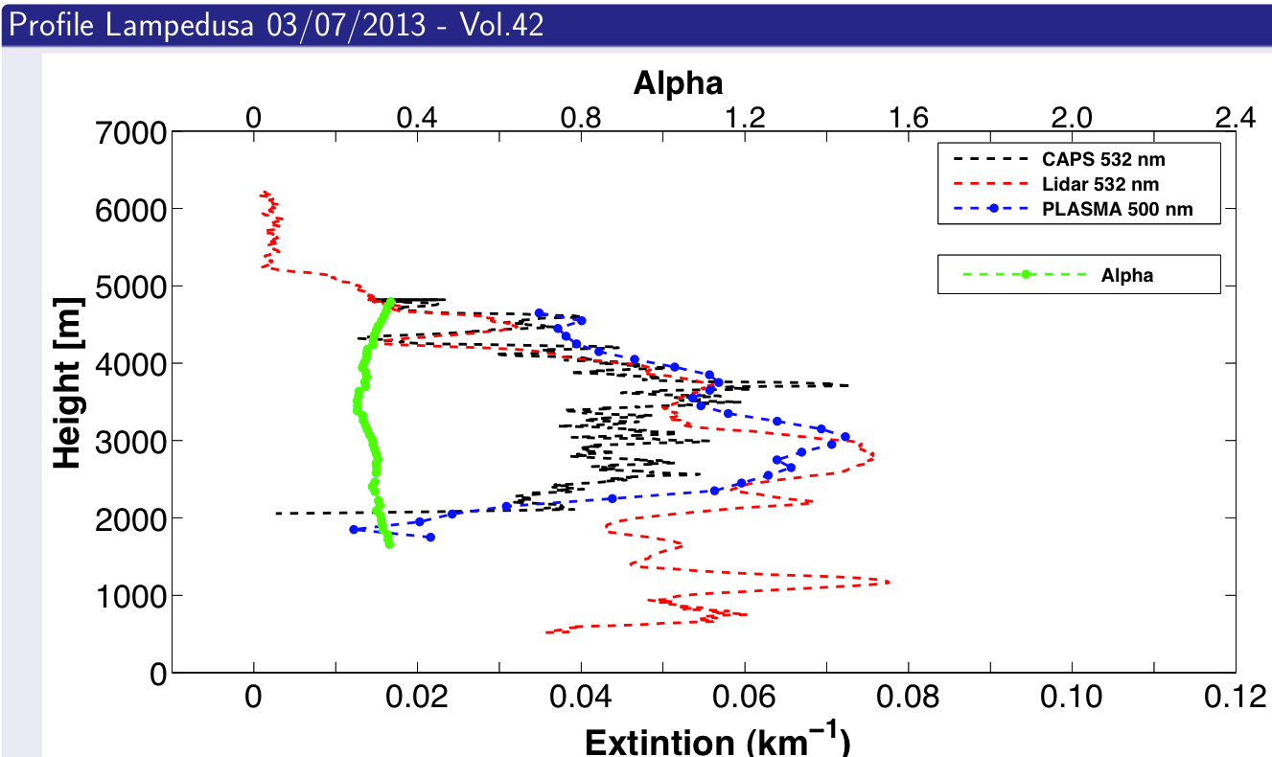

Slide 14
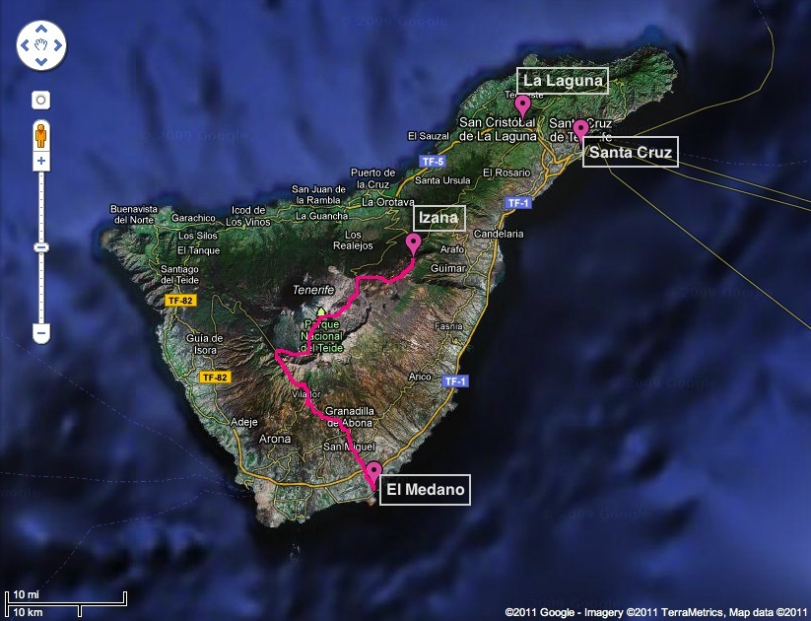
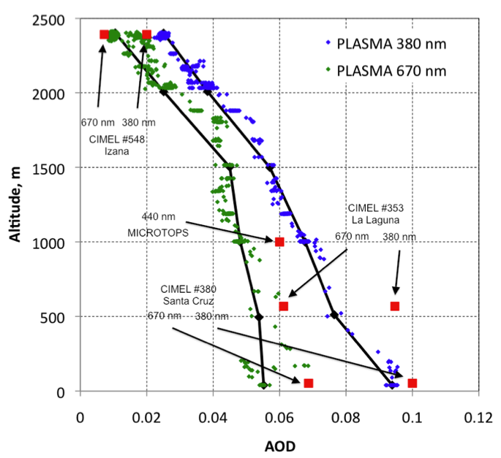
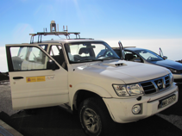
Automobile measurements: Tenerife experiment
13/01/2011

Slide 15
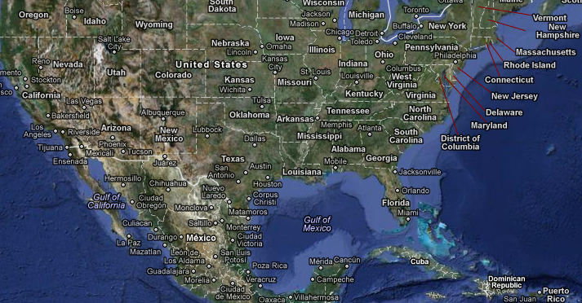
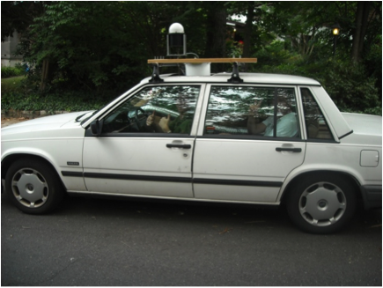
Automobile measurements: DRAGON campaign
20/07/2011
PLASMA AOD
Lidar profile
Mortier et al., 2012

Slide 16
Automobile measurements: DRAGON campaign
PLASMA vs. AERONET DRAGON
20/07/2011

Slide 17
References :
Sauvage B., Mise au point d’un photomètre multispectral embarqué sur avion (PLASMA) : participation et analyse de campagnes de mesures, Mémoire de stage de Master 2 de Béatrice Sauvage Parcours recherche ‘Optique, Physique Moléculaire et Atmosphérique’, Laboratoire d’Optique Atmosphérique, Lille 1, Juin 2008
Karol Y., D. Tanre, P. Goloub, C. Vervaerde, J. Y. Balois, L. Blarel, T. Podvin, A. Mortier, A. Chaikovsky, Airborne sunphotometer PLASMA: concept, measurements, comparison of aerosol extinction vertical profile with lidar, Atmos. Meas. Tech. Discuss., 5, 1–22, 2012 http://www.atmos-meas-tech-discuss.net/5/1/2012/ doi:10.5194/amtd-5-1-2012/
Karol Y., Determination of optical and microphysical properties of atmospheric aerosols
from multi-wavelength airborne sun photometer, Thèse en co-tutelle Lille1-NBAS, 2013.
Mortier A., P. Goloub, B. Holben, T . Podvin, L. Blarel, C. Verwaerde, Y. Karol, I. Slutsker, J- Y. Balois, D. Tanre, T. Berkoff, S Victori and R. Mathieu, Aerosol spatial distribution during DRAGON experiment as seen by a mobile ground-based Lidar-Sunphotometer system, International Laser and Radar Conference, Jun 25-29th 2012, Porto Heli, Greece, P. 411-414
Torres et al, Plasma in Charmex, ChArMEx Results & Perspectives Meeting, Paris (Ballon de Paris, Parc André Citroën) 16-17 Sept. 2013
Torres et al, ADRIMED/Plasma and Lampedusa, Meeting Lampedusa, Créteil (LISA), 24-25 October 2013.
Torres et al, First Retrievals Of Aerosol Properties Derived From Measurements Of The New Airborne Sunphotometer PLASMA During The Campaigns SHADOWS And ChArMEx. 7th International Workshop on Sand/Duststorms and Associated Dustfall, ESA/ESRIN, Frascati (Rome), Italy, 2-4 December 2013.
Torres et al., first analysis of the aerosol properties derived from Measurements Of The New Airborne Sunphotometer PLASMA During The Campaigns SHADOWS And ChArMEx. Ateliers de Modélisation de l'Atmosphère 2014, Toulouse, France, 20-22 January 2014.

Slide 18
The team:
C. Vervaerde, L. Blarel, T. Podvin, J.-Y. Balois, A. Mortier, B. Torres, P. Goloub, D. Tanré, Y. Karol, R. Loisil, C. Delegove
(with contributions from O. Dubovik, T. Lapionak, Y. Derimian)

